Slide 1

Super-Earth Real Estate
SMU FinTech Team 3

Slide 2
Introduction
Julian
Auction land on the new super-Earth planet discovered recently and make available for purchase via our blockchain token.
Register and update the star land registry dApp, pin an star land File to IPFS via Pinata.
All property contracts are encrypted and tokenized on Solidity Remix IDE

Slide 3


Our Team –
Allyssa Carmin
Vicky Lee
Julian Louden
Noman Zubairi

Slide 4
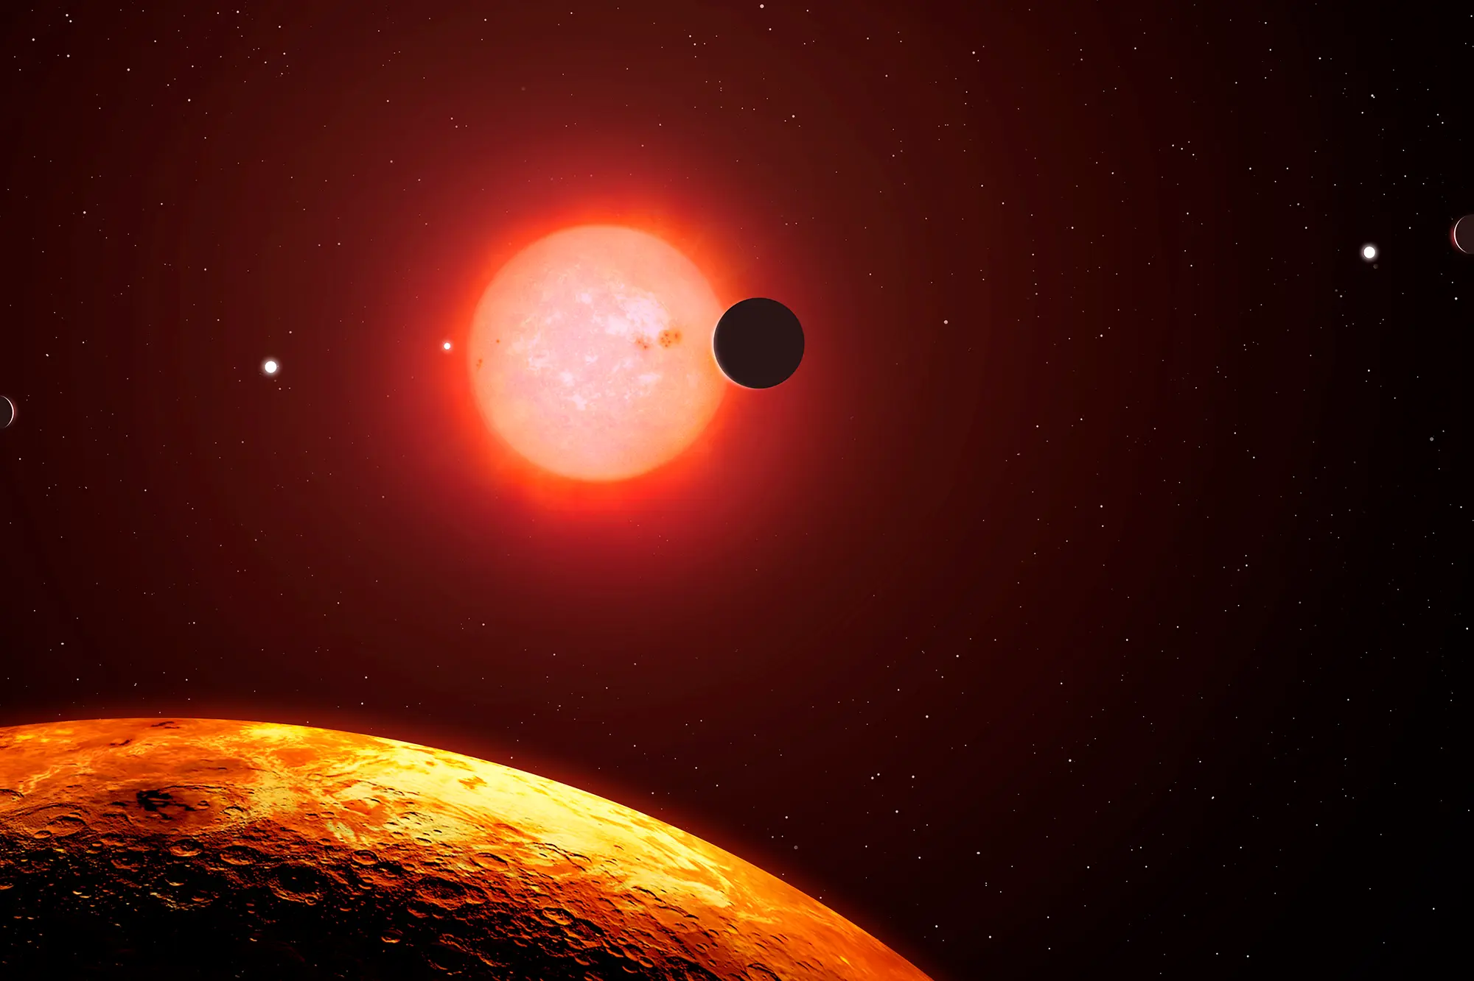
What is LP 890-9c?
Julian
Also known as SPECULOOS-2 or TOI-4306, is a high proper motion red dwarf star located 105 light-years away from the Solar System in the constellation of Eridanus.
It is the second-coolest star found to host a planetary system, after TRAPPIST-1.

Slide 5
Current Property Offerings
Julian
Whether you’ll eventually visit the Super-Earth as a tourist, to do scientific research, to mine for Helium3 or other valuable rare-earth elements, the Moon offers a wealth of fascinating locations.
Land 1
Land 2
Land 3
Land 4
Land 5

Slide 6
Book your Journey to Super-Earth Today!
Talking Points
Not certain which region to select? Click on the region name above to access a detailed description and location information. It's that easy to buy Super-Earth property!
WE DELIVER EVERYWHERE AROUND THE WORLD!
All property prices are stated in ETH per acre based on current exchange rates.

Slide 7
Encrypted and Secure (NFT) Contracts
Talking Points
Your property ownership contract is encrypted and tokenized on the Solidity Smart Chain, and is accessible only through your secure, private portal – an exclusive feature available only to our clients!

Slide 8
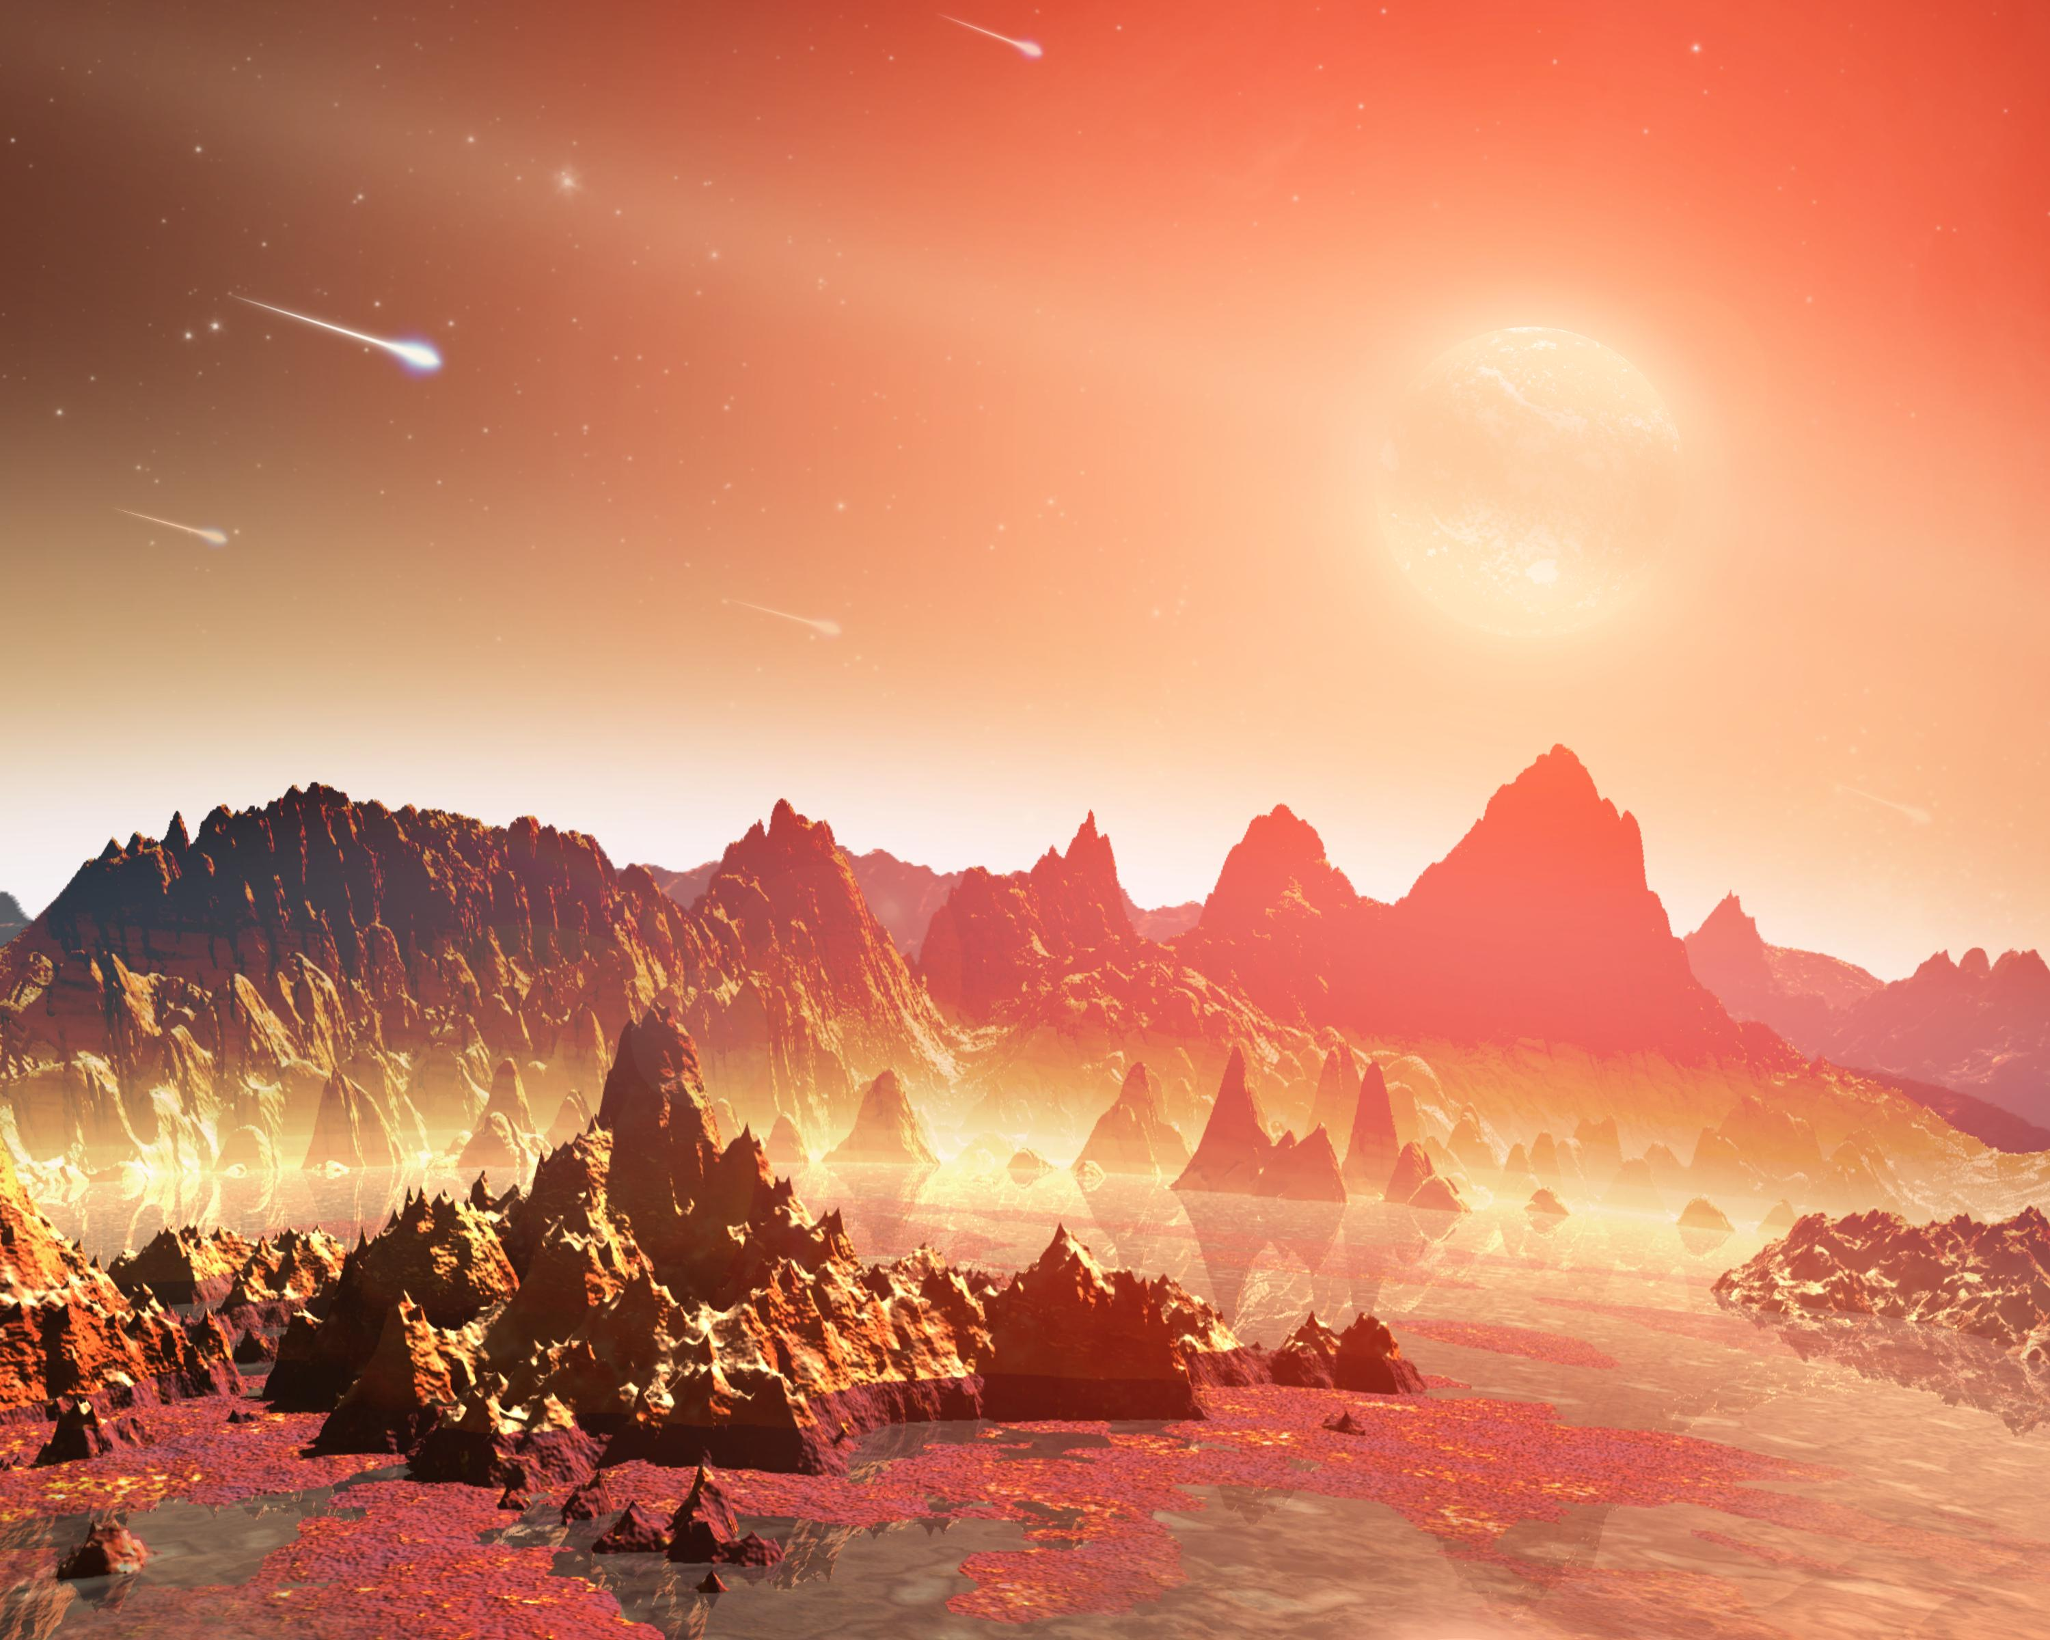
Demo
Allyssa
This artist conception shows a young, hypothetical planet around a cool star. A soupy mix of potentially life-forming chemicals can be seen pooling around the base of the jagged rocks.

Slide 9
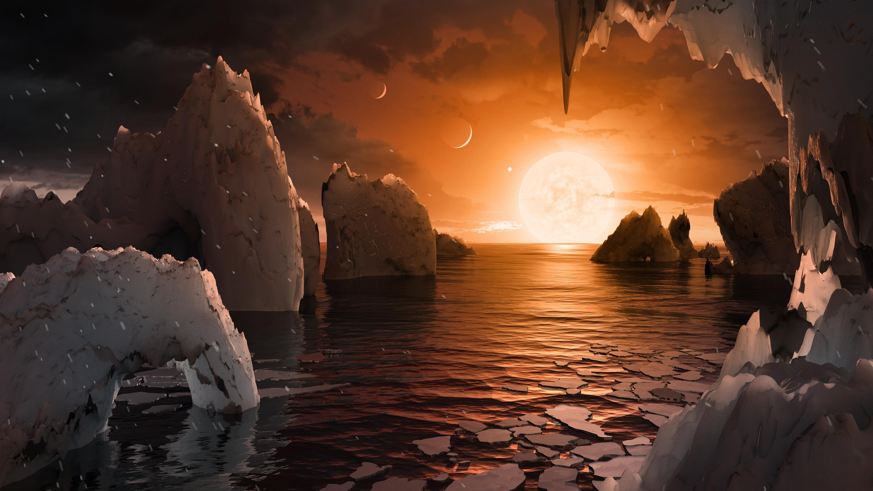
Demo
Allyssa
This artist's concept allows us to imagine what it would be like to stand on the surface of the exoplanet TRAPPIST-1F.
Notes:
Located in the TRAPPIST-1 system in the constellation Aquarius. Because this planet is thought to be tidally locked to its star, meaning the same face of the planet is always pointed at the star, there would be a region called the terminator that perpetually divides day and night. If the night side is icy, the day side might give way to liquid water in the area where sufficient starlight hits the surface. One of the unusual features of TRAPPIST-1 planets is how close they are to each other -- so close that other planets could be visible in the sky from the surface of each one.
In this view, the planets in the sky correspond to TRAPPIST1e (top left crescent), d (middle crescent) and c (bright dot to the lower right of the crescents). TRAPPIST-1e would appear about the same size as the moon and TRAPPIST1-c is on the far side of the star. The star itself, an ultra-cool dwarf, would appear about three times larger than our own sun does in Earth's skies.

Slide 10
Demo - Streamlit
List resources here

Slide 11
Demo - Streamlit
Noman
List activities here

Slide 12
Demo - Steamlit
Noman
Noman to upload a video, demonstrating the streamlit application here

Slide 13
Demo - Streamlit
Noman
List resources here

Slide 14

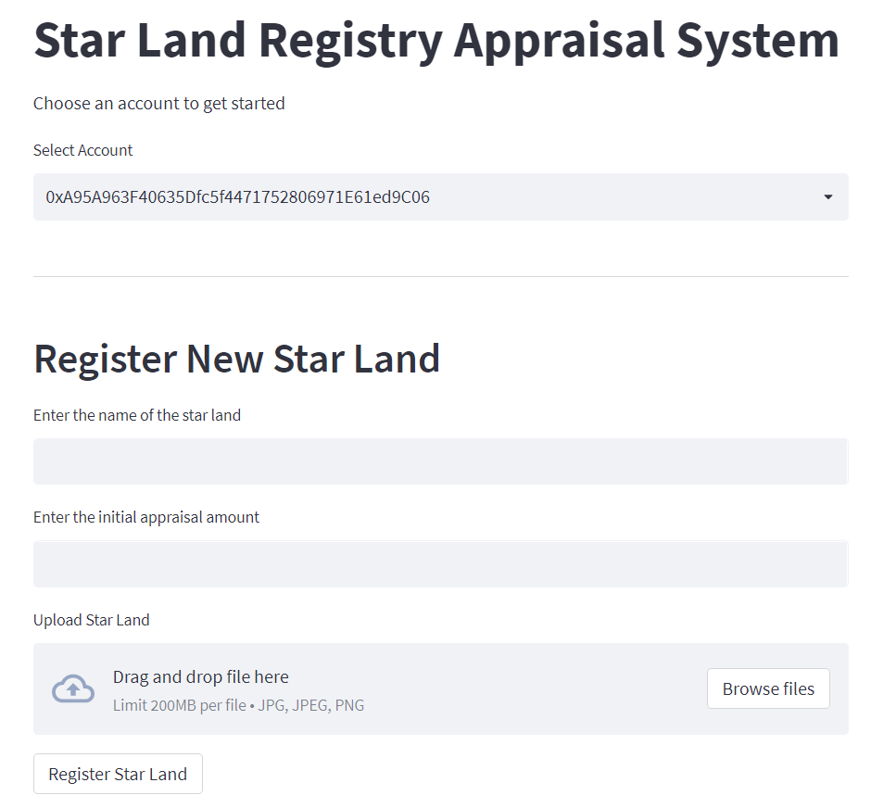
Star Land Registry & Appraisal System
Vicky

Slide 15
Demo
Vicky
Vicky to upload a video, demonstrating the star land registry system here

Slide 16
Demo
List resources here

Slide 17
Product Roadmap
Q1
Q2
Q3
Q4
MILESTONE
MILESTONE
MILESTONE
MILESTONE
Certification
Appraisal System
Text
Text.

Slide 18

Questions?
Questions?
Ready to get started?
Choose your landing site on the Super-Earth!

